Slide 1

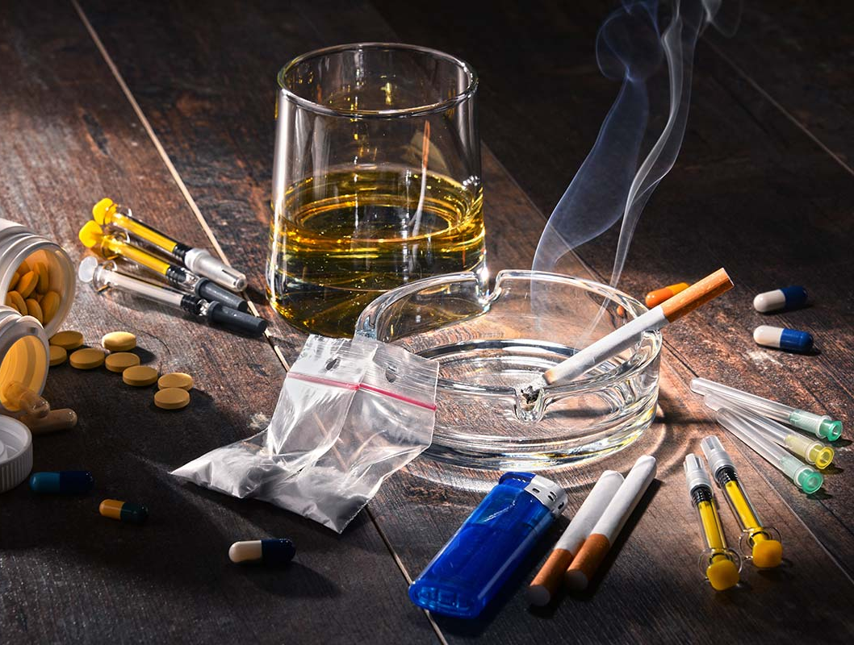
Python for Data Analysis - Project - Drug Consumption Analysis / Predictions

Slide 2
Data Set
More informations : https://archive.ics.uci.edu/ml/datasets/Drug+consumption+%28quantified%29
5 Demographic Features
19 Drug Consumption targets
Alcohol Amphetamines Amyl nitrite Benzodiazepine Caffeine Chocolate Cocaïne Crack Ecstasy Heroin | Ketamine Legal highs Lysergic acid diethylamide Methadone Magic mushrooms Nicotine Volatile substance abuse Fictitious drug Semeron*
Age Gender Education | Country Ethnicity
7 Personality Features
Neuroticism Extraversion Openness to experience | Agreeableness Conscientiousness Impulsiveness Sensation seeking
*note : that last drug is ficticious : it will be removed from
the dataset as well as the participants who lied about it

Slide 3
Problems we’ll try to solve

Slide 4
Variables created
Dataframes
df : contains all the dataset from the csv file
df_drugs : contains all the 7 definitions of the classes (replacing 0 by ‘Never used’, etc.)
df_corr : correlation matrix of the dataframe
Y_drugs : contains a binary value for each drug column : 0 for ‘not user’ and 1 for ‘user’
Lists
demographic : names of the demographic columns
personality : names of the personality columns
drugs : names of the drug consumption columns
age_cat : scaled values of ages converted to category values
gender_cat : scaled values of genders converted to category values
education_cat : scaled values of educations converted to category values
country_cat : scaled values of countries converted to category values
ethnicity_cat : scaled values of ethnicities converted to category values
algos : dictionnary containing classification algorithmes we will use, and their parameters we will try
ests : result of the function predict_all_consumptions
Functions
frequency_plots : function to give for each column of a dataframe, a pie chart and a barplot of value counts
plot_and_table : function to give for a given column of a dataframe, a pie chart, a barplot and a tab of value counts
test_algo : applies a gridsearchcv and returns the best estimator and best score
classifiers_test : returns a list of estimators for each algorithmes
disp_scores : plot a confusion matrix and a pie chart of the success rate
predict_all_consumptions : returns list of the best estimator for each target of the problem

Slide 5
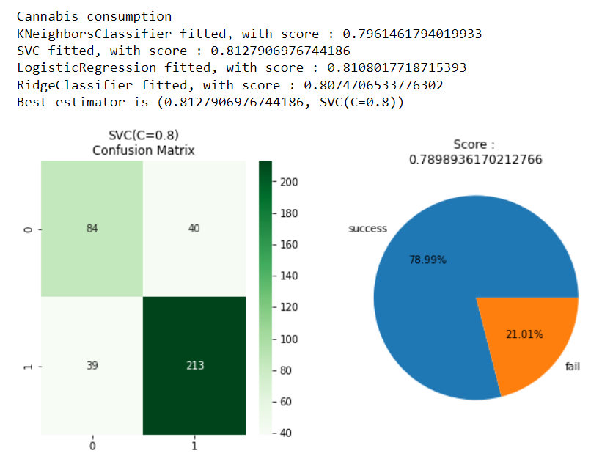
Predicting consumer / not consumer
→ For each drug, we take the 6 most correlated features with the target and we try some algorithmes with different parameters, and we display the best estimator for each algorithm, the the best of them, and we display the confusion matrix and success rate between real test values and predicted test values. Then we save the estimator.

Slide 6
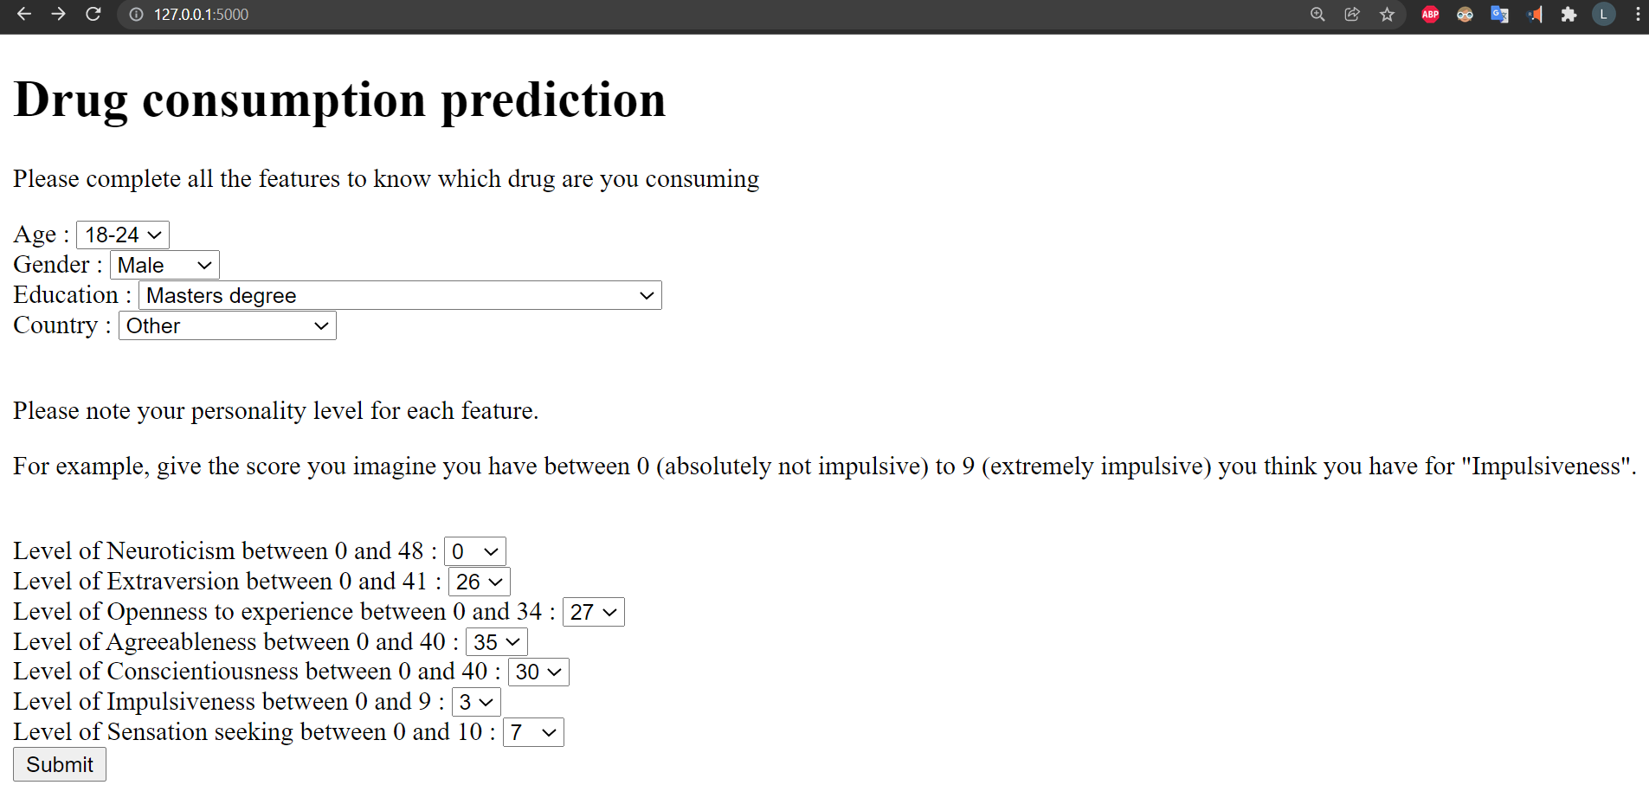
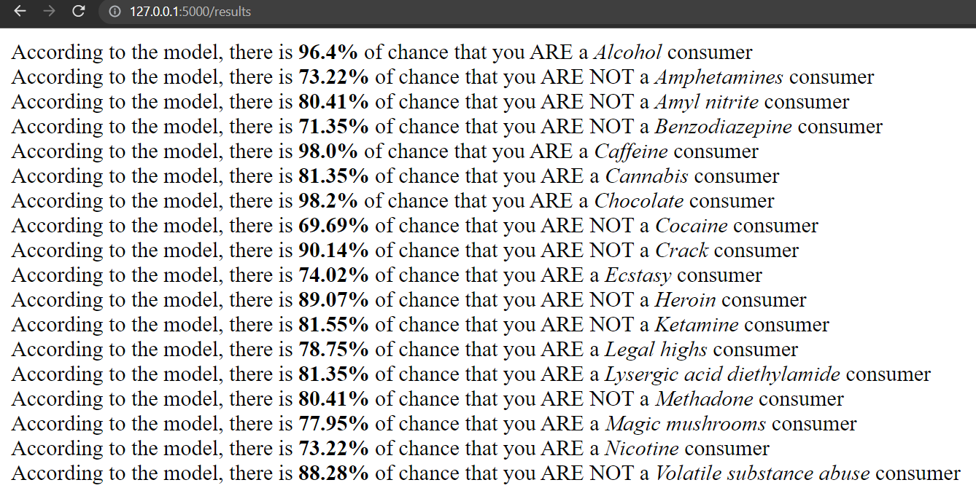
API : Flask
Remarks : In the home page, you can choose some features and give yourself a score of your personality characters. When you submit, the API predicts if you are a drug consumer for each drug with the best model we saved in the notebook.
If there is an error when you press submit button, try to run app.py with anaconda

